Slide 1
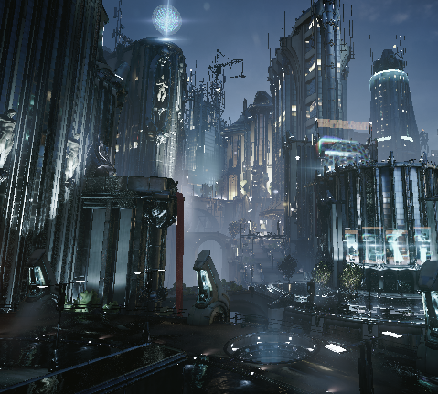
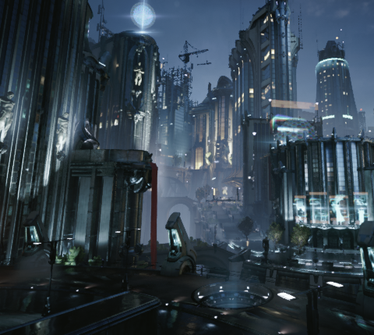



High Quality Temporal Supersampling
Brian Karis (@BrianKaris)

Slide 2
Context
Unreal Engine 4’s primary anti-aliasing solution
Referred to as Temporal AA in the engine
First used in the UE4 Infiltrator tech demo
Several major revisions since then
Still ongoing work
Notes:
https://www.youtube.com/watch?v=dO2rM-l-vdQ

Slide 3
UE4 renderer
Deferred shading
Physically based
HDR
Notes:
I don’t intend to give a complete overview of the UE4 renderer as it would take too long.
It is important to mention a few key aspects that influence choices for anti-aliasing.

Slide 4
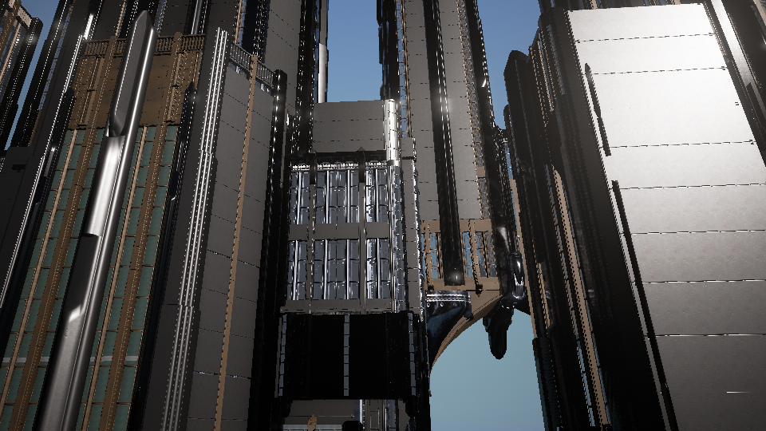
No AA
Notes:
This was some early experimental content for the infiltrator demo.
The artists were experimenting with different ways to create content which were becoming increasingly aliasing unfriendly.
They came to us and said if we can’t get better anti-aliasing we are going to have to change direction, basically throwing down the gauntlet.

Slide 5

FXAA
Notes:
This is what we had at the time, FXAA, which you can see hardly helps.

Slide 6
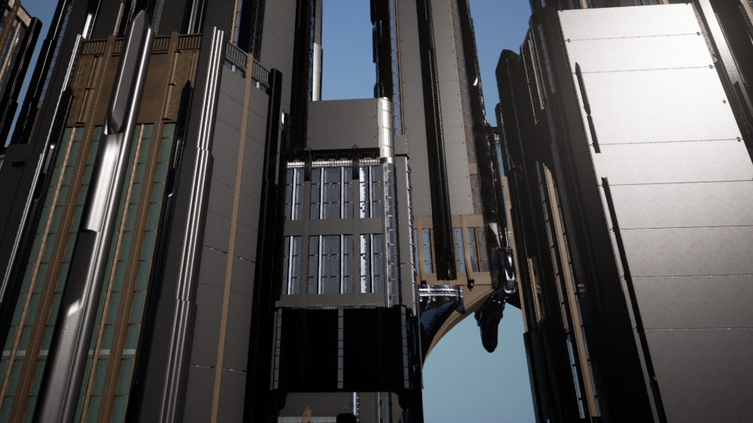
Temporal AA
Notes:
This is what we want. It is the result of the temporal super-sampling algorithm I am about to explain.

Slide 7
Problem
Horrifically aliased input
Both geometric and shading aliasing
Mostly from subpixel features
Want temporal stability

Slide 8
MSAA?
Too expensive with deferred
Don’t want to shade more than once per pixel
Doesn’t affect shading aliasing
More significant aliasing inside triangles than at their edges
Notes:
MSAA with deferred increases the GBuffer size and resolve cost significantly.
In addition, it forces shading at more than once per pixel.
Even if the cost weren’t a problem, MSAA only reduces geometric aliasing. It does nothing for shading aliasing.

Slide 9
Spatial filter?
MLAA, FXAA, SMAA, etc.
Essentially edge finding, reduces stair stepping
Primarily not a stair stepping problem
No knowledge of subpixel features
Not temporally stable
Even on simple stair stepping
[Reshetov09], [Lottes11], [Jimenez12]
Notes:
How about morphologic anti-aliasing and its kin?
I already showed the results of FXAA which performed poorly. Why?
These are essentially edge finding algorithms with the goal of reducing stair stepping.
Our problem is primarily not stepping. It is subpixel aliasing which a spatial filter can’t possibly reconstruct.
Even on simple stair stepping it should be noted that spatial filters won’t be temporally stable.

Slide 10
Specular Lobe filtering?
Toksvig, LEAN, vMF, etc.
Filters shading input to prevent subpixel shading output
Difficult to pre-filter everything
Geometric features are major contributor
Often no existing unique roughness map
Procedural texturing
Still aliases
Screen space filter aliases
Misses subpixel features
[Hill12], [Neubelt13], [Mittring12]
Notes:
How about specular lobe filtering as a way to prevent shading aliasing?
These are things like Toksvig, LEAN mapping and the like which filter shading input to prevent subpixel shading output.
This will filter a bumpy surface with very tight specular lobes to be a less bumpy surface with broader specular lobes to reduce aliasing.
This can be done at little cost with prefiltering. When you can you absolutely should do this to maintain the appearance of surfaces at a distance but in many cases it is difficult to prefilter.
Unless there is a unique normal and roughness map, geometric details can’t be prefiltered.
Epic the artists use often use a lot of procedural texturing which can be impossible to precompute anything for.
To deal with the geometry problem these filters can be applied in screen space, something we presented a couple of years ago and was used in the Elemental demo. Of course, a screen space filter can’t capture subpixel features.

Slide 11
Temporal filtering
Distribute samples over multiple frames
I’ve had great success with this in the past
SSAO
SSR
Replaced spatial filter
Higher quality
Cheaper
Do the same with supersampling?
Notes:
Amortized numerical integration
Same concept as accumulation buffer techniques

Slide 12
Step 1: Static scene

Slide 13
Jittering
Adjust projection matrix
ProjMatrix[2][0] += ( SampleX * 2.0f – 1.0f ) / ViewRect.Width();
ProjMatrix[2][1] += ( SampleY * 2.0f – 1.0f ) / ViewRect.Height();
Regular grid
Notes:
First we need a way to generate our super samples.
The simplest way is to offset the projection matrix by a subpixel amount.
The rest of the renderer doesn’t have to know anything about this (mostly).

Slide 14
Sample pattern
Want a low discrepancy progressive sequence
No clustering in either space or time
Halton (2,3) worked well enough
Better than any HW MSAA sample ordering
8
5
2
Halton
7
4
1
6
3
Notes:
But don’t use a regular grid like traditional super sampling.
There’s no reason sample positions from different frames need to be aligned to a grid.
Each new sample should be well distributed compared to most recent samples.
This is to say, samples shouldn’t be clustered in either space or time.
This sounds similar to a low discrepancy progressive sequence.
Halton surely isn’t perfect for this use but worked well enough
http://en.wikipedia.org/wiki/Halton_sequence

Slide 15
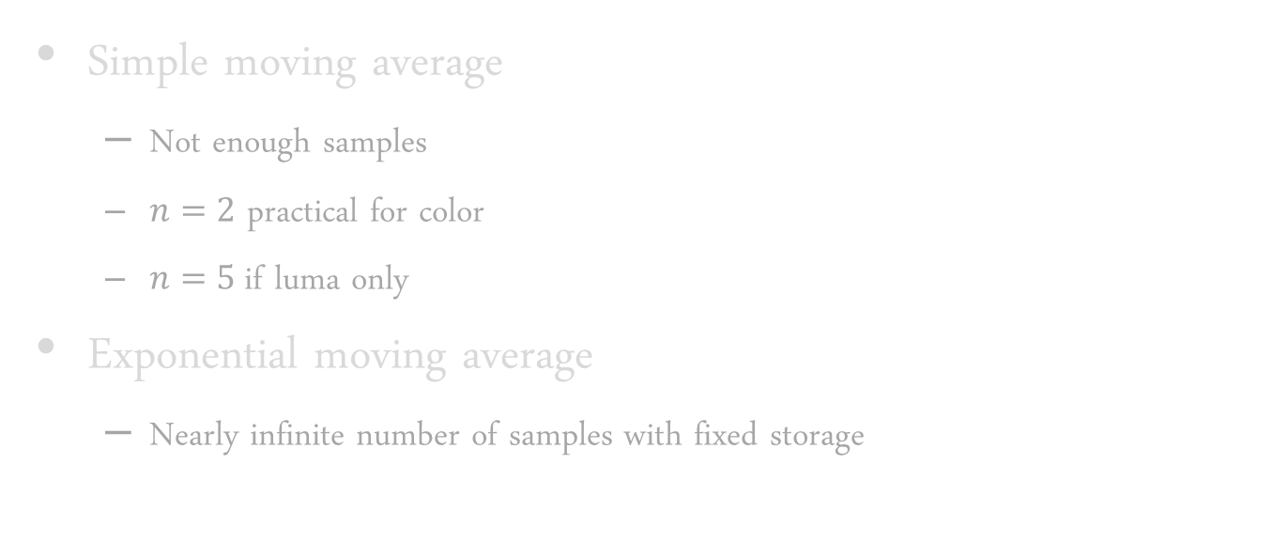


Moving average
Simple moving average
Not enough samples
$n=2$ practical for color
$n=5$ if luma only
Exponential moving average
Nearly infinite number of samples with fixed storage
$$s_{t}=\frac{1}{n}\sum_{k=0}^{n−1}{x_{t−k}}$$
$$s_{t}=αx_{t}+\left(1−α\right)s_{t−1}$$
Notes:
Now that we have samples, how do we accumulate them?
FPS smoothing analogy.
We use 8-16 samples in practice for fast convergence.

Slide 16




Exponential smoothing
When $α$ is small exponential $≈$ simple
$$s_{t}=αx_{t}+\left(1−α\right)s_{t−1}=α\sum_{k=0}^{∞}{{\left(1−α\right)}^{k}x_{t−k}}$$
$$x_{t}=x_{t−n}⇒s_{t}=\frac{α}{{1−\left(1−α\right)}^{n}}\sum_{k=0}^{n−1}{{\left(1−α\right)}^{k}x_{t−k}}$$
$$\lim_{α→0}{\frac{α}{{1−\left(1−α\right)}^{n}}\sum_{k=0}^{n−1}{{\left(1−α\right)}^{k}x_{t−k}}=\frac{1}{n}\sum_{k=0}^{n−1}{x_{t−k}}}$$
Notes:
If alpha, the blend factor, becomes small, an exponential moving average will approach a simple moving average, which is what we want.
A simple way of thinking about this is: the smaller the blend factor, the smaller the difference in weight between successive samples.

Slide 17
When to average?
Before tone mapping
The physically correct location
Bright values dominate
Aliases badly with limited # of samples
After tone mapping
All post filters flicker
Aliased input → aliased output

Slide 18
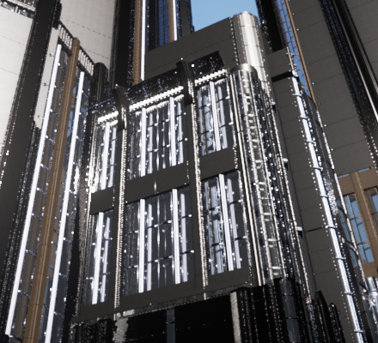
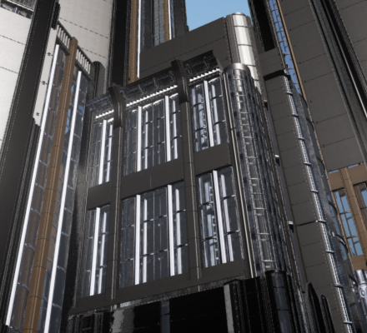
Before vs After
Before
Tone map
After
Image

Slide 19
Straightforward tone map solution
Hybrid of before and after
Apply before all post
Tone map input
Accumulate samples
Reverse tone map output
Same AA quality as after tone mapping
Provides AAed input to post processing chain
No more flickering bloom

Slide 20



Better tone map solution
Tone mapping desaturates bright pixels
Weight samples instead based on luminance
Maintains chroma
Perceptually closer to ground truth
No need to store the weight
Rederive weight
Saves GPRs
See my blog post: [Karis13]
$$weight=\frac{1}{1+luma}$$
$$T(color)=\frac{color}{1+luma}$$
$$T^{−1}(color)=\frac{color}{1−luma}$$
Notes:
Think of like perceptual blending

Slide 21
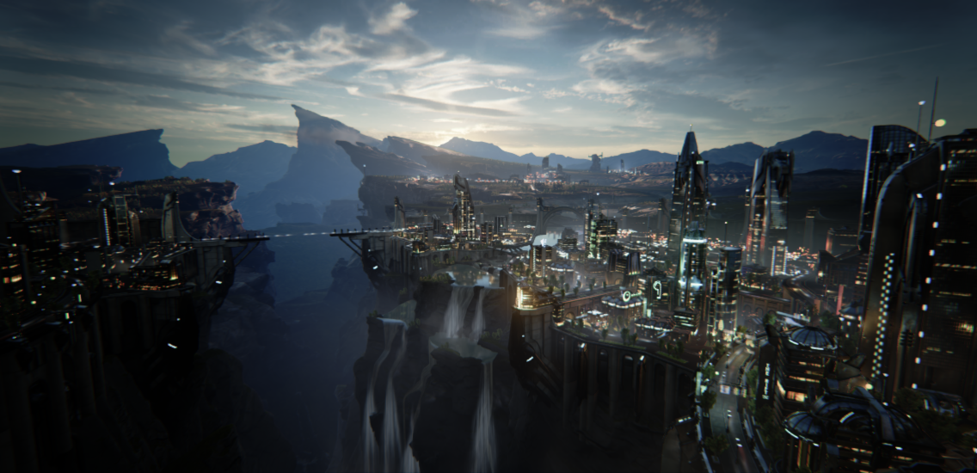
Tone map vs luma weight
Tone map
Side by side image of skybox

Slide 22
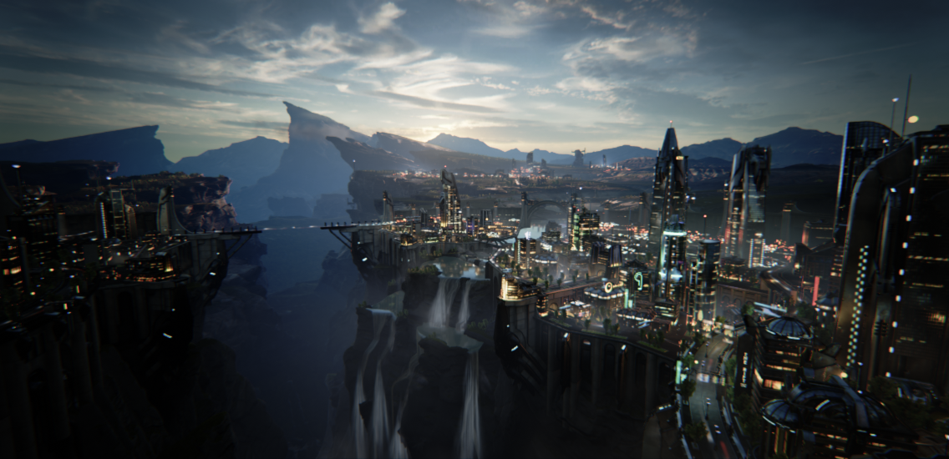
Tone map vs luma weight
Luma weight
Side by side image of skybox

Slide 23
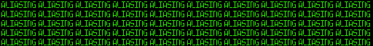
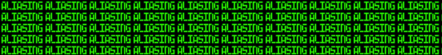
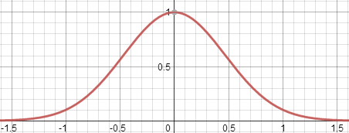

Reconstruction filter
Box filter is not stable under motion
PRMan anti-aliasing guide
Gaussian fit to Blackman-Harris 3.3
Support is ~2 pixels wide
Box
Gaussian
$$W(x)=e^{−2.29x^{2}}$$
[Burley07]
Notes:
For the reconstruction filter, the simplest filter kernel is a box. Any sample within the pixel rectangle is averaged. This is what hardware MSAA resolves do.
Edge quality is poor but even worse it isn’t stable under motion. This is due to the sharp edges of the box. Sample weights need to fall off smoothly to have stable motion.
This is a well researched topic. PRMan documentation has suggestions for the best filter kernel and parameters.
Unfortunately due to our low sample count, kernels with negative lobes don’t work well so we use the Blackman-Harris filter.
Every pixel shares the same jitter so filter weights are calculated on CPU and passed as shader uniforms.

Slide 24
Step 2: Dynamic scene

Slide 25
Reprojection
History for current pixel may be elsewhere on screen
May not exist at all
Use same velocity buffer calculation as motion blur
Remember to remove jitter
Notes:
Due to movement the history for the current pixel may be elsewhere on screen so we need to reproject the history buffer.
Remove jitter
Don’t want to reproject in static jittering case

Slide 26
Velocity accuracy
Need velocity (motion vectors) for everything
Motion without correct velocity will smear
Accuracy is super important
Minor imprecision will streak a static image
16:16 RG velocity buffer
Can be tricky
Procedural animation
Scrolling textures
Almost opaque translucent objects

Slide 27
Motion on edges
Moving silhouette edges lose AA
Smooth AAed edge doesn’t move with object
Effectively an aliased mask in the velocity buffer
Dilate velocity
Take front most velocity
Notes:
Within objects this reprojection does a great job and AA will accumulate properly under motion.
Unfortunately, silhouette edges lose AA under motion.
Much of the fringe of AA around an object is outside of the rendered velocity.
We want to keep the AAed edge with the object as it moves.
So we dilate the velocity to cover fringe.
This is done simply by taking the velocity of the nearest of 5 samples in an X pattern.
Somewhat unexpectedly we need to dilate by 2 pixels instead of 1 which is due to the wider filter kernel

Slide 28
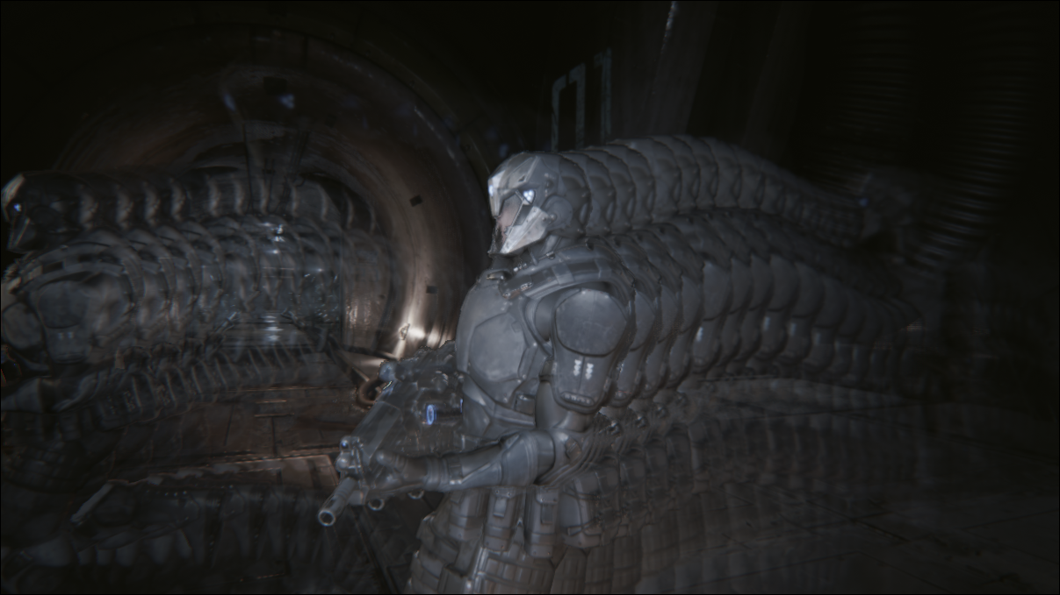
Ghosting
Notes:
When reprojecting, not all pixel’s history will be valid.
We need to detect when it isn’t.
Invalid pixel history appears as ghosting.

Slide 29
Ghosting
Depth compare?
All samples don’t share same depth
Velocity weighting?
Shading changes
Translucency
[Nehab07], [Sousa11]
Notes:
How to detect invalid history?
Depth compare
Velocity weighting as introduced by Crytek.
Reject history when velocity differs
This can be effective for moving solid objects but not shading, translucency.
For example lights turning on and off or an explosion particle effect.

Slide 30

Neighborhood clamping
New kid in town!
[Lottes11] , [Malan12]
Restrict history to the range of current frame’s local neighborhood
Assumes AA result is blend of neighbors
Clamp with min/max of 3x3 neighborhood
Notes:
There’s a new kid in town! Or at least when I started it was.
The idea is to restrict the history to the range of current frame’s local neighborhood.
This assumes that the AA result is a blend of the color present in the local neighborhood. If there are no subpixel features this is provably true. Even will subpixel features this is a fair assumption.
I’ll cover what to do about the artifacts when this assumption is false later.
This is implemented as simply clamping history to the min and max RGB in a 3x3 neighborhood.
The diagram is showing clamping a red history to the RGB bounding box.

Slide 31
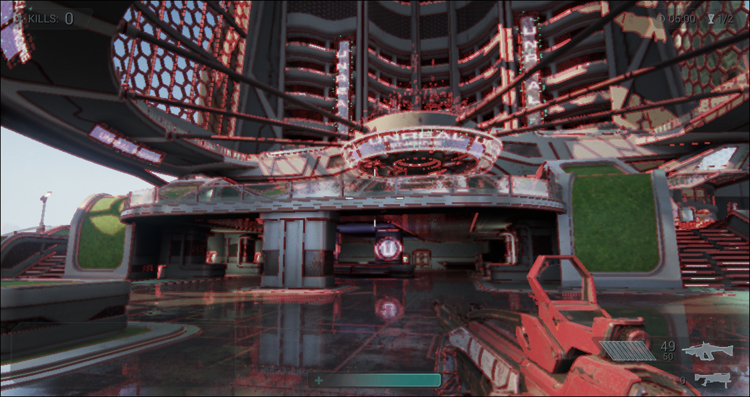
Neighborhood clamping artifacts
Notes:
This image shows basic neighborhood clamping against red history.
There are a number of artifacts here. The most obvious is there are red bits of ghosting at every edge. A bit more subtle is that the image looks like it is low res nearest filtered.

Slide 32
Shaped neighborhood clamp
Simple clamp to min/max of 8 neighbors results in 3x3 box artifacts
Want min/max to appear filtered
Round out the shape
Solution: average 2 neighborhood’s min/max
Notes:
Lets attack the filtered problem first.
A min or max local value will turn into a 3x3 box which appears like low res pixels.
We’d like it to appear filtered, as if it were just a blurrier version of the scene.
These still need to be mins and maxes though.

Slide 33
YCoCg box
Basic min/max is an AABB in RGB space
Ideally use convex hull of neighborhood colors
Too expensive
Orient box in luma direction
Luma has high local contrast
Chroma typically doesn’t
Notes:
Next lets attack the red edge issue.

Slide 34
Clip instead of clamp
Constrain to a blend of history and neighborhood average
Clip line segment to box
Colors don’t collect in box corners like clamping does

Slide 35
Basic min/max RGB clamp
Notes:
These images show neighborhood clamping against red history.

Slide 36
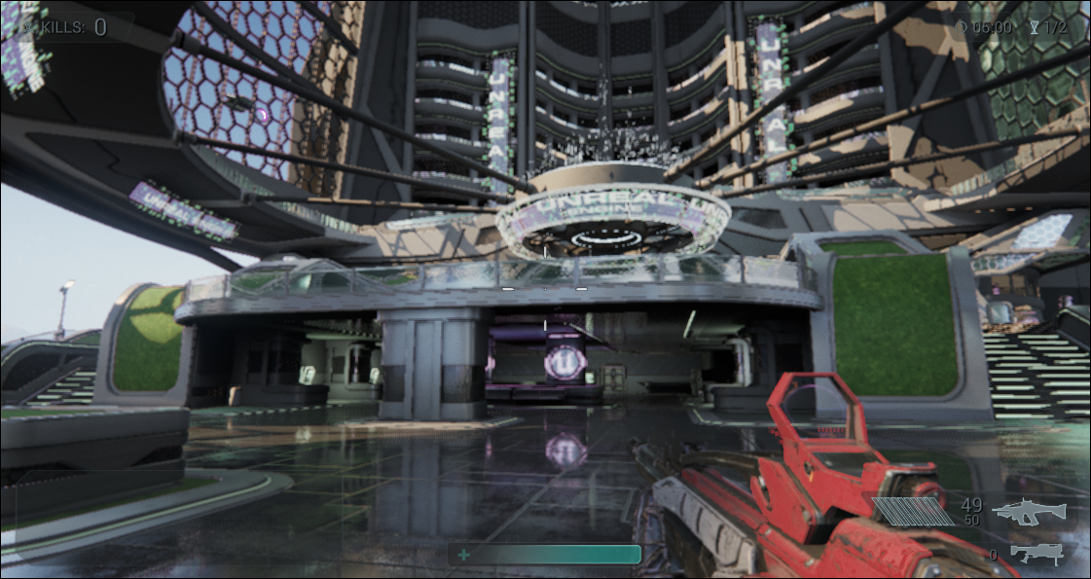
Clipped to shaped YCoCg box

Slide 37
Translucency
Translucency is a poor fit for temporal
Single history
Single velocity
Ideally render translucency separate and composite
Can’t unjitter depth buffer to compare against
Possible solution: 4xMSAA depth prepass
Alternate which sample to shade
Notes:
Although we have a ghosting solution that handles translucency, translucency is really just a poor fit for temporal in the first place.
There can’t be a single history to reproject.
Ideally, we could run temporal AA on opaque surfaces and render translucency after.
The problem is translucency still needs to depth test and the only depth available is jittering.
We can’t unjitter the depth buffer and
Doing some sort of temporal aa of depth is problematic. I’ve tried.
Possible solution:

Slide 38
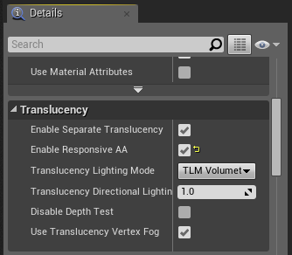
Our translucency solution
“Responsive AA” material flag
Sets stencil when rendering translucency
Temporal AA pass tests stencil and uses minimal feedback
Unfortunately need >0 feedback to prevent visible jittering
Only useful for small particles like sparks
Neighborhood clamping handles the rest
Notes:
“Responsive AA” material flag
Sets stencil when rendering translucency
Temporal AA pass tests stencil and uses minimal feedback
This gives the minimal amount of feedback to avoid visible jittering while staying as responsive as possible.
Only useful for small particles like sparks
Neighborhood clamping handles the rest

Slide 39
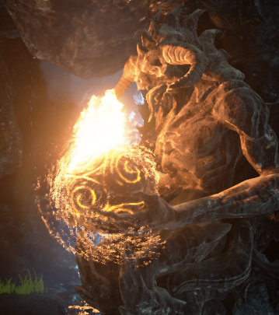

Without
Responsive AA

Slide 40
Temporal AA is a firewall
Visibility samples
Spatial filters
GBuffer
Lighting
Translucency
TAA
Bloom
DOF
Post
Depth
Temporal AA
Notes:
Along these lines temporal AA needs to be treated like a firewall.
I’ve already mentioned some of the issues the happen when this is violated.
Any non-color values used after temporal AA will jitter and alias
Depth!
Any spatial filter applied before temporal AA which expands an aliased signal larger than 3x3 pixels will flicker
Neighborhood clamping sees this as a change.
DOF is a perfect example.

Slide 41
Temporal AA is a firewall
Visibility samples
Spatial filters
GBuffer
Lighting
Translucency
TAA
Bloom
Post
DOF Setup
TAA
DOF
Temporal AA
Notes:
Used for DOF and light shafts
They add up but in each case half resolution
Uses simplified algorithm
Other spatial filter cases are avoided
This can be limiting

Slide 42
Flickering
Camera is static but some pixels flicker
Missing subpixel feature’s history gets clamped
Often vertical or horizontal lines due to coherent jitter
Clamping is an instantaneous impulse
This leads to saw tooth waves which appear as flickering
Bright edge missing in one frame
Notes:
There are two very difficult quality issues to discuss. The first of which is flickering.
With a static camera some pixels will flicker, alternate between light and dark.
Why does this happen?
This is the aforementioned negative effect of neighborhood assumption when subpixel features are present.
When a feature is small enough to not be present in any of the 9 pixels in the neighborhood the history of it will be clamped out as if it disappeared.

Slide 43
Basic anti-flickering idea
Bias towards impulse frame
Shrinks amplitude of wave
Reduce exponential smoothing blend factor
Reduces recovery from impulses
Only where needed
Overly blurry results if done everywhere
Bright edge missing in one frame

Slide 44
First anti-flickering attempt
Store historical variance data in alpha channel
Remember clamping events
Reduce blend factor and recover over time
Responsiveness issues
Can result in ghosting or blurring
Can bias towards aliased result
Notes:
In normal clamping case we want fast convergence. Reducing the blend factor slows convergence.

Slide 45
Our current anti-flickering solution
Reduce blend factor when history is near clamping
Will happen after clamp events
Memory specific to event
Doesn’t require additional storage
Not completely solved
Extremely difficult!
Impossible to solve multiple opposing clamps

Slide 46
Blurring: filter kernel
Mipmap bias all textures
Incorrect derivatives for supersampling
If low contrast then reduce filter kernel size
Technically aliases but looks fine
Can add additional post sharpen filter
Mitchell 4.0 filter’s negative lobes are >1 pixel away

Slide 47
Blurring: reprojection diffusion
Could use back and forth error compensation
Haven’t had good results
Could store history at higher resolution
Really expensive
When reprojecting outside pixel reduce filter size and feedback
[Valient14], [Yang09]

Slide 48
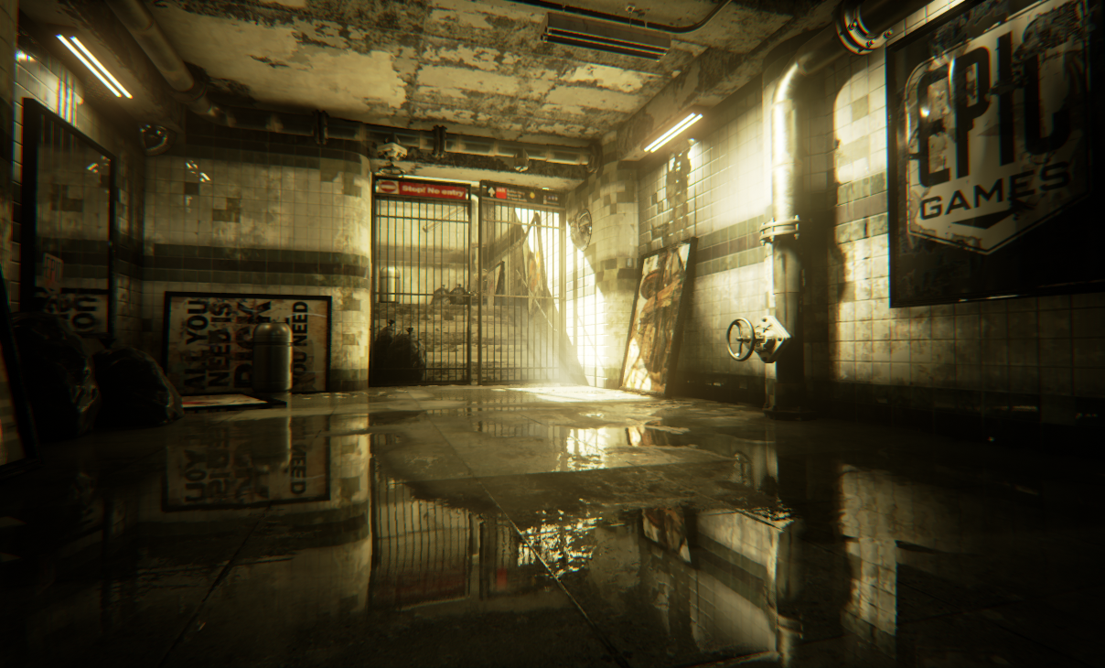
Noise filter
Not its original purpose
Really nice side effect
Used for SSR and SSAO
Stochastic sampling works pretty well
Doesn’t cost anything extra
Almost perfect mirror reflections with only 16 ray march steps

Slide 49
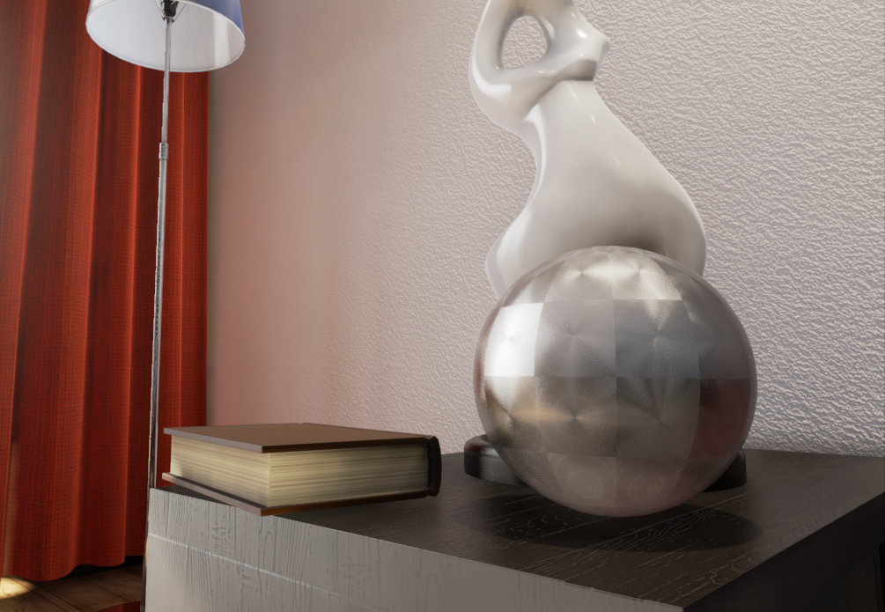
Many more potential applications
Stochastic transparency
Single sample anisotropic specular IBL
Soft shadows
Reduced steps for ray casting
Parallax occlusion mapping
Volumetric lighting
Path tracing?
VR?
Anisotropic specular
Notes:
Has its limits. Neighborhood clamping only works with reasonable levels of noise.
Incredible how far this algorithm seems to be able to be pushed.

Slide 50
Video

Slide 51
Future directions
Combine spatial and temporal
Separate translucency
Visibility and shading sample disconnect
Different jitter per pixel
Custom MSAA sample placement
More complete motion vectors
Translucency
Motion estimation

Slide 52
Conclusion
Temporal supersampling is production ready
High quality
High performance
Needs a lot of perceptual tuning
Notes:
Production ready. Primary UE4 AA solution.
Fast enough even for Nvidia’s K1 tablet as used in the Rivalry demo recently showed at Google IO.

Slide 53
Thanks
Timothy Lottes, co-inventor
Epic
Rendering team

Slide 54
Full source code available!
unrealengine.com
$19/mo + 5%
Epic is hiring!
Notes:
Reference implementation is in UE4.
Good news is the complete source code is available now!

Slide 55
References
[Burley07] “Filtering in PRMan” http://www.renderman.org/RMR/st/PRMan_Filtering/Filtering_In_PRMan.html
[Hill12] “Rock-Solid Shading: Image Stability Without Sacrificing Detail”
http://advances.realtimerendering.com/s2012/Ubisoft/Rock-Solid%20Shading.pdf
[Jimenez12] “SMAA: Enhanced Subpixel Morphological Antialiasing” http://www.iryoku.com/smaa/
[Karis13] “Tone mapping” http://graphicrants.blogspot.com/2013/12/tone-mapping.html
[Lottes11] “FXAA” http://developer.download.nvidia.com/assets/gamedev/files/sdk/11/FXAA_WhitePaper.pdf
[Lottes11] http://timothylottes.blogspot.com/2011/04/tssaa-temporal-super-sampling-aa.html
[Malan12] “Real-Time Global Illumination and Reflections in Dust 514” http://advances.realtimerendering.com/s2012/CCP/Malan-Dust_514_GI_reflections(Siggraph2012).pptx
[Mittring12] “The Technology Behind the Unreal Engine 4 Elemental demo” http://advances.realtimerendering.com/s2012/Epic/The%20Technology%20Behind%20the%20Elemental%20Demo%2016x9.pptx
[Nehab07] “Accelerating Real-Time Shading with Reverse Reprojection Caching” http://gfx.cs.princeton.edu/pubs/Nehab_2007_ARS/NehEtAl07.pdf
[Neubelt13] “Crafting a Next-Gen Material Pipeline for The Order: 1886” http://blog.selfshadow.com/publications/s2013-shading-course/
[Reshetov09] “Morphological antialiasing” http://visual-computing.intel-research.net/publications/papers/2009/mlaa/mlaa.pdf
[Sousa11] “Anti-Aliasing Methods in CryENGINE 3” http://www.crytek.com/cryengine/presentations/anti-aliasing-methods-in-cryengine-3
[Valient14] “Taking Killzone Shadow Fall Image Quality into the Next Generation” http://www.guerrilla-games.com/presentations/GDC2014_Valient_Killzone_Graphics.pdf
[Yang09] “Amortized Supersampling” http://www.cs.virginia.edu/~gfx/pubs/Yang_2009_AMS/yang2009.pdf

